Slide 1
Chapter 3
Continuous System Simulation

Slide 2
Continuous System Simulation
A continuous system is one in which the predominant activities of the system cause smooth changes in the attributes of system entities
When such a system is modeled mathematically, the variables of models representing the attributes are controlled by continuous functions.
Continuous System Simulation describes how mathematical models of dynamic systems, usually described by sets of differential equations possibly coupled with algebraic equations can be simulated

Slide 3
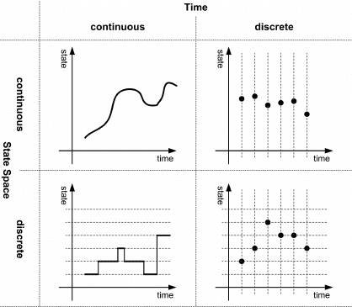
Continuous System Simulation
In general, in continious, the relationship describes the rate at which attributes changes, so that the model consists of differential equations.

Slide 4
Differential Equations
A differential equation is a mathematical equation which relates some function with its derivatives, where functions usually represents physical quantities, the derivatives represent rate of change and equation represents relation between two.
We can use differential equations to represent the behavior of continuous systems.
The typical example of linear differential equation with constant coefficients is used to describe the wheel suspension system of automobile.

Slide 5
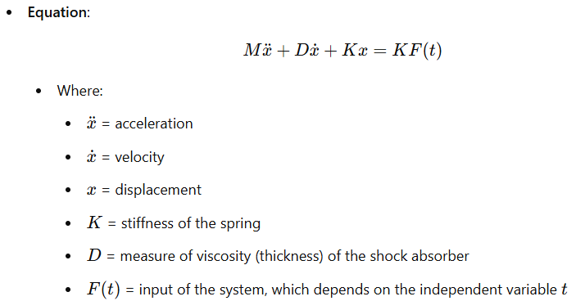
Dependent variable x, Independent variable t, Input F(t).

Slide 6
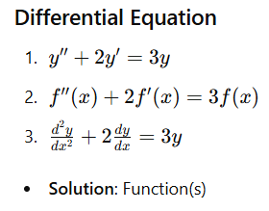
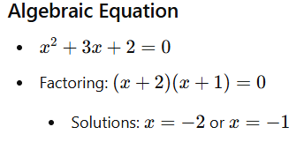

Slide 7
Significance of Differential Equations:
The most physical and chemical process involves rate of change which requires differential equation for their mathematical description.
Since a differential coefficient can also represent a growth rate, continuous models can also be applied to problems of social or economic nature where there is a need to understand general effects of growth trend.
Differential equations can be used to represent different engineering problems as in describing behavior of automobile wheel suspension, with mechanical principles.
Differential equations are extensively used to describe analytical solutions of different system.
Differential equations are extensively used in simulating behavior of real operational system using electrical circuits.

Slide 8
Differential Equations summery
We can use differential equations to represent the behavior of continuous systems.
Differential equations are extensively used in scientific and engineering studies.
They are crucial for describing rates of change in physical and chemical processes, which require precise mathematical descriptions.
Growth Rate Models: Differential equations with constant coefficients can also represent growth models and be applied to social or economic systems.

Slide 9
Analog Computer
An analog computer is a form of computer that uses continuously changeable aspects of the physical phenomena such as electrical, mechanical or hydraulic quantities to model the problem being solved.
An analog computer is a computer which is used to process analog data.
Analog computer does not use discrete values but rather continuous values.
Processes cannot be reliably repeated with exact equivalence.
Examples of analog computers are slide rule, nomogram, oscilloscope, television, analog sound processor, flight simulator etc.

Slide 10
Analog Computer
The most widely used form of analog computer is the electronic analog computer, based on the use of high gain dc (direct current) amplifiers, called operational amplifiers.
Voltages in the computer are equated to mathematical variables, and the operational amplifiers can add and integrate the voltages.
With appropriate circuits, an amplifier can be made to add several input voltages, each representing a variable of the model, to produce a voltage representing the sum of the input variables.

Slide 11
The core mathematical operations used in an electric analog computer are:
Addition
Integration with respect to time
Inversion
Multiplication
Exponentiation
Logarithm
Division
Differentiation with respect to time is not frequently used, and in practice is avoided by redefining the problem when possible.

Slide 12
Analog Computer
Different scale factors can be used on the inputs to represent coefficients of the model equations.
Amplifiers that sums different terms are called summers.
Another circuit arrangement produces an integrator for which the output is the integral with respect to time of a single input voltage or the sum of several input voltages.
All voltages can be positive or negative to correspond to the sign of the variable represented.
Tosatisfy the equations of the model, it is sometimes necessary to use a sign inverter, which is an amplifier designed to cause the output to reverse the sign of the input.

Slide 13
Pros and Cons of Analog Computer
Advantages (Pros):
The analog computer do not suffer quantization noise but are limited by analog noise.
Analog computers are widely used in scientific and industrial applications where digital computers lack sufficient performance, like flight computer in aircrafts, for teaching control system in universities.
The analog representation of a system is often more natural as it directly reflects the structure of system; thus simplifying both the setting up of a simulation and interpretation of results.
The analog computer is faster than digital under certain circumstances as it could solve many equations in simultaneous manner while digital computer can be working on one equation at a time.

Slide 14
Disadvantages (Cons):
An analog computer have limited accuracy and dedication to one particular problem, may not be significant.
Electronic analog computer have limited accuracy due to following reasons-
It is difficult to carry the accuracy of measuring a voltage beyond a certain point
A number of assumptions are made in deriving relationship for operational amplifiers, none of which is strictly true.
The assumption that there should be zero output voltage for zero input voltage is difficult to achieve.
Operational amplifiers have limited dynamic range of outputs, so scale factor must be introduced to keep within range.

Slide 15
Advantages of Digital Computer
Any degree of accuracy can be programmed virtually in digital computer with floating point representation of numbers, so an extremely wide range of variations can be tolerated.
A digital computer has advantages of being easily used for many different problems.

Slide 16
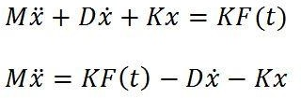
Analog methods: Example
1.Analog Computer Model of Automobile Suspension
The general method by which analog computers are applied can be demonstrated using the second-order differential equation that has already been discussed:
Solving the equation for the highest order derivative gives:

Slide 17
Suppose a variable representing the input F(t) is supplied, and assume for the time being that there exist variables representing -x and -ẋ.
These three variables can be scaled and added with asummer to produce a voltage representing M ẍ.
Integrating this variable with a scale factor of 1/M produces ẋ.
Changing the sign produces - ẋ, which supplies one of the variables initially assumed; and a further integration produces -x, which was the other assumed variable.

Slide 18
For convenience, a further sign inverter is included to produce +x as anoutput.
A block diagram to solve the problem in this manner is shown in following Figure.

Slide 19
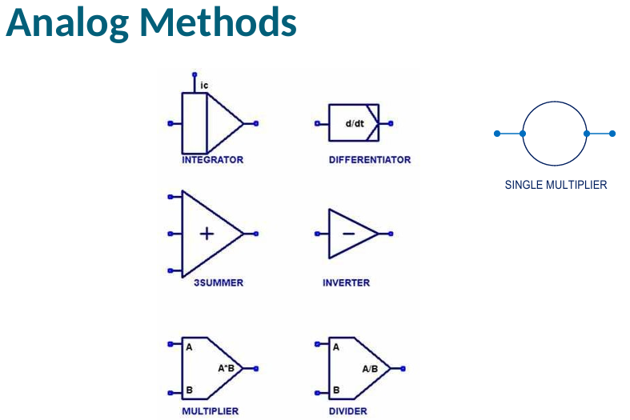

Slide 20
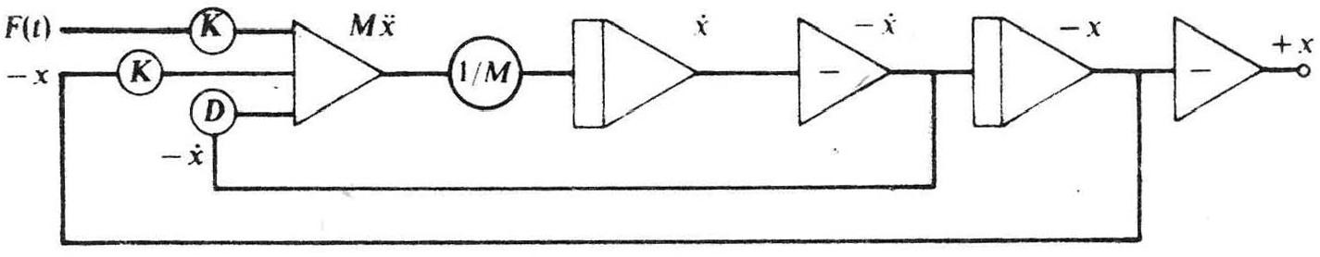
Figure: Analog Computer model for the automobile suspension problem

Slide 21
The symbols used in the figure are standard symbols for drawing block diagrams representing analog computer arrangements.
The circles indicate scale factors applied to the variables.
The triangular symbol at the left of the figure represents the operation of adding variables.
The triangular symbol with a vertical bar represents an integration, and the one containing a minus sign is a sign changer.

Slide 22
The addition on the left, with its associated scaling factors, corresponds to the addition of the variables representing the three forces on the wheel, producing a variable representing M ẍ.
With an electronic analog computer, the variables that have been described would be voltages, and the symbols would represent operational amplifiers arranged as adders, integrators, andsign changers.

Slide 23
The above Figure would then represent how the amplifiers are interconnected to solve the equation.
It should be pointed out, however, that there can be several ways of drawing a diagram for aparticular problem, depending upon which variables are of interest, and on the size of the scale factors.

Slide 24
Hybrid Computers
The hybrid computers are the combination of the traditional analog-computer elements, giving smooth continuous outputs and the elements carrying out such non linear, digital operations as storing values, switching and performing logical operations.
Originally the term ‘hybrid computer’ had connotation of extending analog-computer capabilities, usually by the addition of special-purpose and often specially constructed devices.
Hybrid computers may be used to simulate systems that are mainly continuous but in fact have some digital elements.
For example, an artificial satellite for which both continuous equations of motions and the digital control signals must be simulated.

Slide 25
It has the speed of analog computer and the memory and accuracy of digital computer.
Hybrid computers are used in several applications. Such as
Petrol pump – Measurement convert fuel flow into currency rate
Electrocardiogram machine
ATM machine
Control industrial process.
Radar systems etc.

Slide 26
Analog - Digital Simulators
1) To avoid the disadvantage of analog computers, many digital computer programming languages have written to produce digital analog simulator.
Analog computers are good for solving certain continuous problems (like controlling temperature in a system) but have limitations such as less flexibility and more complicated setups. To overcome these limitations, programmers developed digital simulators that can mimic the continuous behavior of analog systems using digital computers.
Example : Think of analog computers like an old radio where you turn a knob to find a station (continuous tuning). Digital computers are more like modern radios with buttons for specific channels (discrete tuning). With digital analog simulators, we’re trying to get the smooth control of the old radio using the precise buttons of the new one.

Slide 27
2) These allow a continuous model to be programmed on a digital computer in a same way as it is solved on an analog computer.
Digital analog simulators let us simulate real-world processes, like temperature changes or electric currents, continuously even though a digital computer normally works with discrete steps. This way, we can model and solve continuous problems on a digital computer similarly to how we would on an analog one.
Example :
Imagine trying to simulate the way water flows in a river. In the real world, water flow is continuous. Digital analog simulators allow us to represent this continuous flow in a digital format, letting us analyze things like flow speed and volume as if it were happening in real time.

Slide 28
3) These languages contain macro instructions that carry out the action of adders, integrators and sign chargers.
Programming languages for digital analog simulators have built-in commands (macro instructions) that can perform complex tasks like adding signals (adders), accumulating values over time (integrators), and changing the direction or sign of a signal (sign chargers).
Example :
Think of these macro instructions like shortcuts in a game. Instead of coding every small step for adding or integrating, you just use a specific command to quickly perform these functions. It’s like pressing a single button to make a character jump, rather than coding the physics of the jump each time.

Slide 29
4) A program uses these macro-instructions to link them together in essentially the same way as operational amplifiers are connected in analog computers.
In analog computers, components like operational amplifiers are connected in certain ways to perform calculations. In a digital analog simulator, these macro instructions are linked together similarly, allowing the program to mimic the behavior of analog setups using digital code.
Example :
Imagine building a model car with LEGO blocks. Each block represents a function like adding or integrating. By connecting the blocks in a specific way, you can create a car model. Similarly, by connecting macro instructions in a program, you can build a digital version of an analog setup.

Slide 30
5) Later more powerful techniques of applying digital computers to the simulation of continuous systems have been developed.
Over time, developers created even more advanced methods for using digital computers to simulate continuous processes, making simulations more accurate and effective than before.
Example :
It’s like the evolution of video games. Early games were simple, but as technology improved, we could create more realistic and complex games. In the same way, simulations have become more advanced, allowing us to model things like weather patterns or traffic flow with greater accuracy.

Slide 31
(CSSLs)
1) CSSLs are the language which use familiar statement type of input for digital computers, allowing a problem to be programmed directly from equations of mathematical model, rather than requiring to be broken into functional elements.
CSSLs (Continuous System Simulation Languages) make it easier to write programs that represent real-world problems, especially those with continuous changes, such as speed, temperature, or population growth. Normally, coding a mathematical model would involve breaking it down into separate parts, but CSSLs allow programmers to enter equations directly. This makes it faster and more intuitive to work with continuous data on a computer.
Imagine you want to model how a car’s speed changes over time. Instead of coding each little piece of the car’s acceleration, you can just enter a speed equation directly into a CSSL, and it will interpret it continuously over time.

Slide 32
2)They could easily include macros, or subroutines that performs the functions of specific analog elements, so it is possible to incorporate convenience of a digital-analog simulator.
CSSLs have "macros" or shortcuts—predefined blocks of code—that act like parts of an analog system, such as adders, integrators, or other functions found in analog computers. These shortcuts allow CSSLs to mimic analog simulators, making it easier to represent continuous systems on a digital platform.
Think of these macros as similar to using pre-built blocks in a building game. Instead of building each function from scratch, you can use pre-made blocks for things like "add," "integrate," or "change sign" to save time and make your code cleaner.

Slide 33
3)The language contains macro instructions which carry out the action of adders, integrators and sign changers.
CSSLs include special instructions, or "macros," for basic functions that are essential in continuous systems. For example:
Adders combine signals.
Integrators accumulate values over time.
Sign changers change the positive or negative sign of a value.
This allows CSSLs to perform these essential operations easily without detailed coding each time.
It’s like a calculator with specific buttons for adding, subtracting, and integrating. These macros make it easy to perform complex operations, much like pressing the “=” button on a calculator to get a result without doing the individual steps manually.

Slide 34
4)CSSLs include a variety of algebraic and logical expressions to describe the relation between variables.
CSSLs can handle complex mathematical relationships using a range of algebraic (like addition, multiplication) and logical expressions (like greater than, equal to). This makes it possible to model interactions and dependencies between different parts of a system.
Imagine you’re modeling a weather system. You’d need equations for temperature, wind, humidity, etc., and each one affects the other. CSSLs let you define these relationships easily, making it possible to see how one variable influences others.

Slide 35
5) CSMP III, or Continuous System Modeling Program IlI is an early scientific computer software designed for modeling and solving differential equations numerically. This enables real-world systems to be simulated and tested with a computer.
CSMP III allowed scientists and engineers to simulate real-world processes by solving differential equations—equations that represent how things change over time. This software was a big deal because it meant you could test and predict system behaviors (like weather patterns or engineering stress tests) without having to physically create or observe the actual process.
Imagine you’re an engineer trying to design a new bridge. You could use CSMP III to simulate how the bridge would react to different weights and weather conditions over time. This saves time, money, and resources compared to building the bridge and testing it directly.

Slide 36
Strucuture
Like all computer programs its analytical and simulation programs are constructed from three general types of statements:
Structural statements, which define the model. They consist of FORTRAN-like programming language statements, and functional blocks of program code (procedures) designed for repeat operations that frequently occur in a model definition.
Data statements, which assign numerical values to various changing parameters, constants, and initial conditions.
Control statements, which specify options in assembly and execution of the program, and the choice of output of the results of the calculations performed.

Slide 37
Structural statements can make use of the operations of addition, subtraction, multiplication, division, and exponentiation, using the same notation and syntax rules as are used in FORTRAN.
If, for example, the model includes the equation
X=6Y/W+(Z-2)^2 the following statement will be used to define the variables and calculus performed:
X=6.0*Y/W+(Z-2.0)**2.0
[real constant also in decimals]
1.2E-4 represents 0.00012

Slide 38


Examples:
•
Y=INTGRL(IC,X) Y(0)=IC INTEGRATOR
Y=EXP(x)
EXPONENTIAL
Y=ln(x)
Y=ALOG(x) EXPONENTIAL
Y=sin(X)
Y=SIN(X) TRIGONOMETRIC SIGN

Slide 39
Data Statement
- These statement designs the numerical values to parameters, constant and initial conditions.
- ICON can be used to set the initial value of the integration block function.
- CONST can be used to set values for constant.
- PARAM is used to set parameters for individual.
- It also can be used to set series of numeric values for one parameter.
Example:
CONST A = 0.5, XDOT = 1.25, YDOT = 6.22
PARAM D = (0.25, 0.50, 0.75, 1.0)
Control Statement
- This statement specifies the option in the execution of the program and the choice of the output.
- TIMER is used to specify the time interval.
Example:
TIMER DELT = 0.005, FINTIM = 15, PRDEL = 0.1, OUTDEL = 0.1
Where DELT = Integration interval
FINTIM = Finish time
PRDEL = Interval at which print results
OUTDEL = Interval at which to print plot

Slide 40
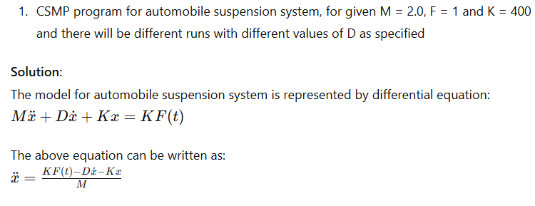
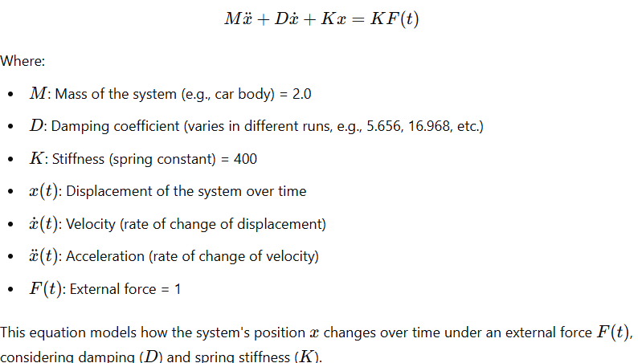
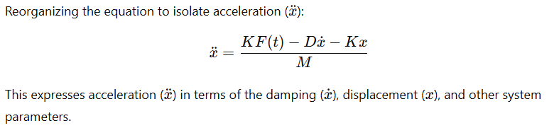
CSMP contains three basic segments:
Initial: executed at the beginning
Terminal: executed at the end of simulation
Dynamic: heart of the program where integration takes place

Slide 41
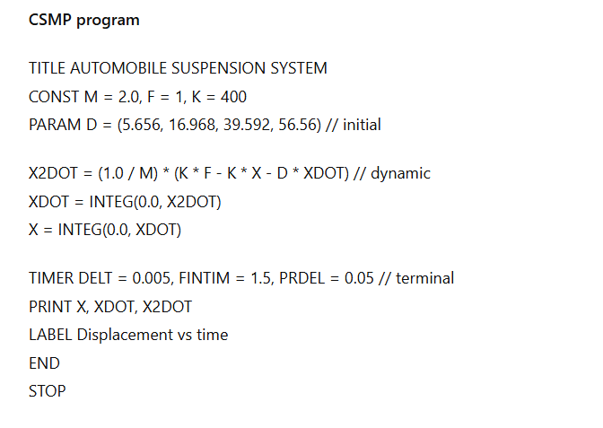

Slide 42
Execution Workflow:
The program starts with the initial conditions (X=0 X DOT=0)
Using the equations, it computes acceleration (X2DOT) at each time step (DELT = 0.005).
Integrates acceleration to get velocity (XDOT) and integrates velocity to get displacement (X).
Prints the result at intervals of PRDEL=0.05 seconds.
Repeats for all specifies D values in PARAM, Simulating how different damping value affects the suspension system.
The output will show how the car’s suspension (displacement, velocity, and acceleration) behaves over time for various damping coefficients. This helps analyze how different levels of damping affect the ride quality or stability.

Slide 43
Feedback Systems
In a feedback system, a portion of the system output is fed back into the system, thus introducing a level of dependencies among input and output signals in the system.
With the use of feedback in communication systems, satisfactory response and robust performance can generally be achieved.
In a system with feedback, also known as a closed-loop control system, the past output may influence the present or future outputs.
Most physical systems embody some form of feedback.
In a system with feedback, a closed sequence of cause-and- effect relations exists between system variables.

Slide 44
There are two types of feedback systems. In a positive feedback system, the feedback is used to increase the input signal level, thus generally making the system unstable.
Positive feedback is widely used in oscillatory circuits such as oscillators and timing circuits.
In a negative feedback system, the feedback is used to decrease the input signal level to ensure system stability.
Tendency toward oscillation or instability is an important characteristic of feedback, and the issue of instability in all feedback systems thus needs to be fully addressed.

Slide 45
A home heating system controlled by a thermostat is a simple example of a feedback system.
The system has a furnace whose purpose is to heat a room, and the output of the system can be measured as room temperature.
Depending upon whether the temperature is below or above the thermostat setting, the furnace will be turned on or off, so that information is being fed back from the output to the input.
In this case, there are only two state, either the furnace is on or off.

Slide 46
Feedback System and Autopilot
An example of a feedback system in which there is continuous control is the aircraft system.
Here, the input is a desired aircraft heading and the output is the actual heading.
The gyroscope of the auto pilot is able to detect the difference between the two headings.
A feedback is established by using the difference to operate the control surface, since change of heading will then affect the signal being used to the heading.
The difference between the desired heading and actual heading is called the error signal, since it is a measure of the extent to which the system deviates from the desired condition.
The feedback in the autopilot is said to be negative feedback.
The more the system output deviates from the desired value stronger is the force to drive it back.

Slide 47
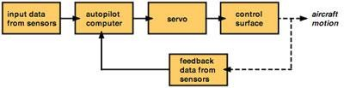
Many simulation studies of continuous system are concerned primarily with the study of servomechanism, which is the general name given to the devices that rely upon feedback for their operation.

Slide 48
Predator-Prey Model
Overview and Mathematical Analysis

Slide 49
Introduction
It is also called parasite-host model.
An environment consists of 2 populations, predator & prey.
Predator-Prey model is also a mathematical model.
The Prey is passive but the Predator depends on the Prey for their source of food.

Slide 50
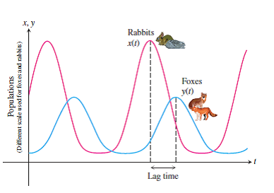
Predator-Prey Model

Slide 51
Definitions
Let:
x(t) = no. of prey population at time t.
y(t) = no. of predator population at time t.
rx(t) = rate of growth of prey for some positive r where r = natural birth rate and natural death rate.

Slide 52
Change in Prey Population
Death rate of prey is proportional to the product of predator and prey populations:
a × x(t) × y(t).
Overall rate of change of prey population:
dx/dt = rx(t) - a x(t)y(t),
where a is a positive constant of proportionality.

Slide 53
Change in Predator Population
Rate of change of predators in the absence of prey is -s y(t), where s is positive.
Interaction between populations causes predator population to increase:
dy/dt = -sy(t) + b x(t)y(t),
where b is a positive constant.

Slide 54
Dynamics and Conclusion
Predator population increase → Prey population decreases.
Decline in prey causes a decrease in predators.
This cycle leads to oscillatory population dynamics.

Slide 55
Assignment
Explain Predator- Prey model with example.
Define continuous system with suitable example. Also differentiate between linear differential and non-linear differential equations.
What do you mean by analog computer? Explain its advantage and disadvantage.
Define CSMP III and explain the types of statement.

Slide 56
The End
https://notes.vedanthakur.com.np/simulation-and-modeling-solved-past-questions-chapter-wise/
notes and past question can be obtained from here

Slide 57
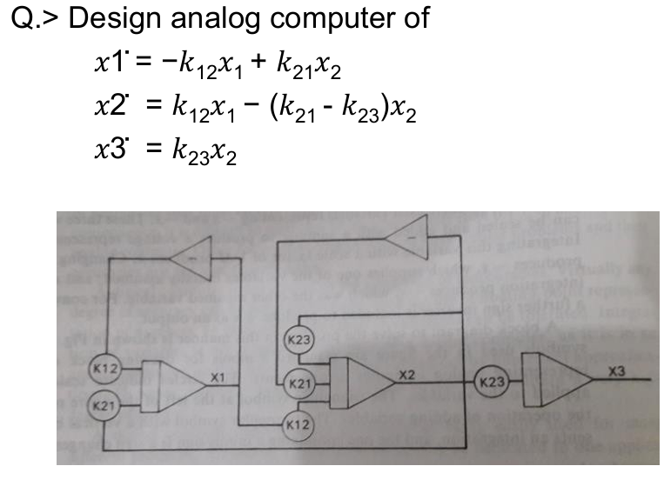

Slide 58
